Slide 1
Uncontrolled copy not subject to amendment
Map Reading
Learning Outcome 3
Be able to plan routes using Ordnance Survey map features and contour lines
Version 2.10 OCT 2014

Slide 2
Visualising the shape of the land

Slide 3
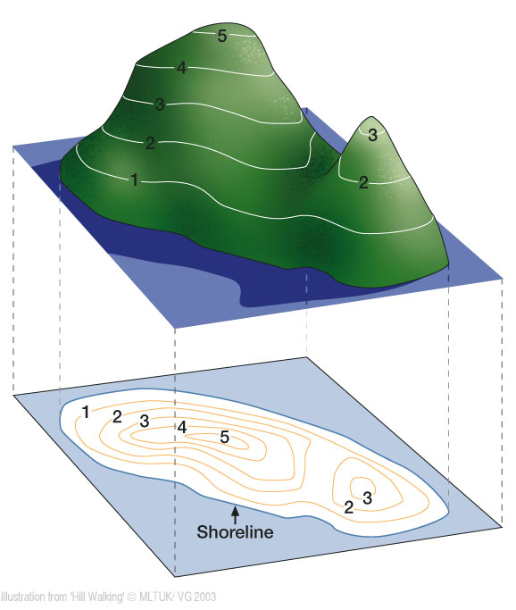
Visualising the shape of the land

Slide 4
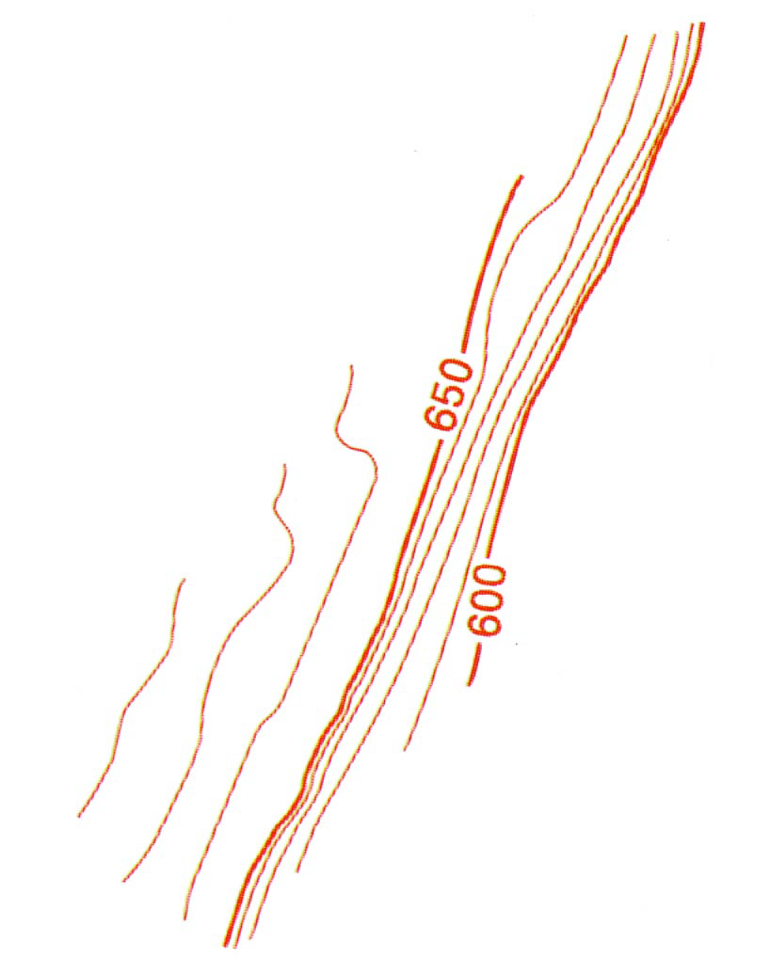
Contour Lines
Contour lines link points of equal height on the map at ten metre intervals
Contours display how many metres land is above sea level

Slide 5
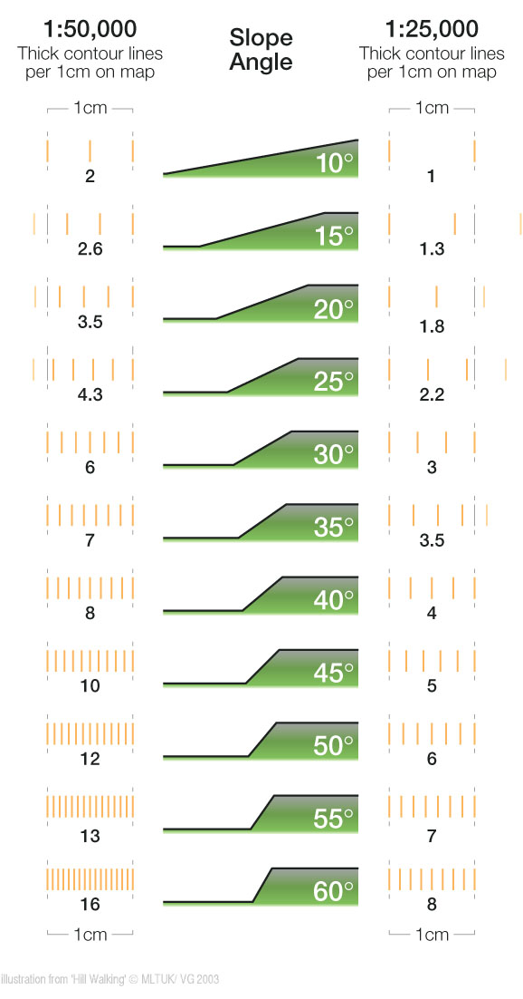
Gradients and Contours

Slide 6
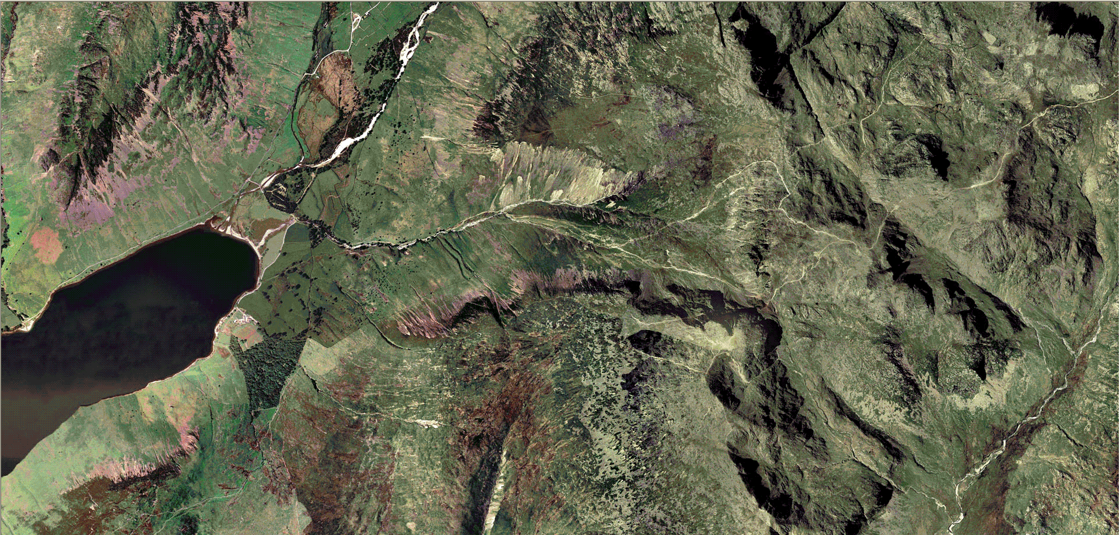
An aerial view of Scafell Pike looks like this

Slide 7
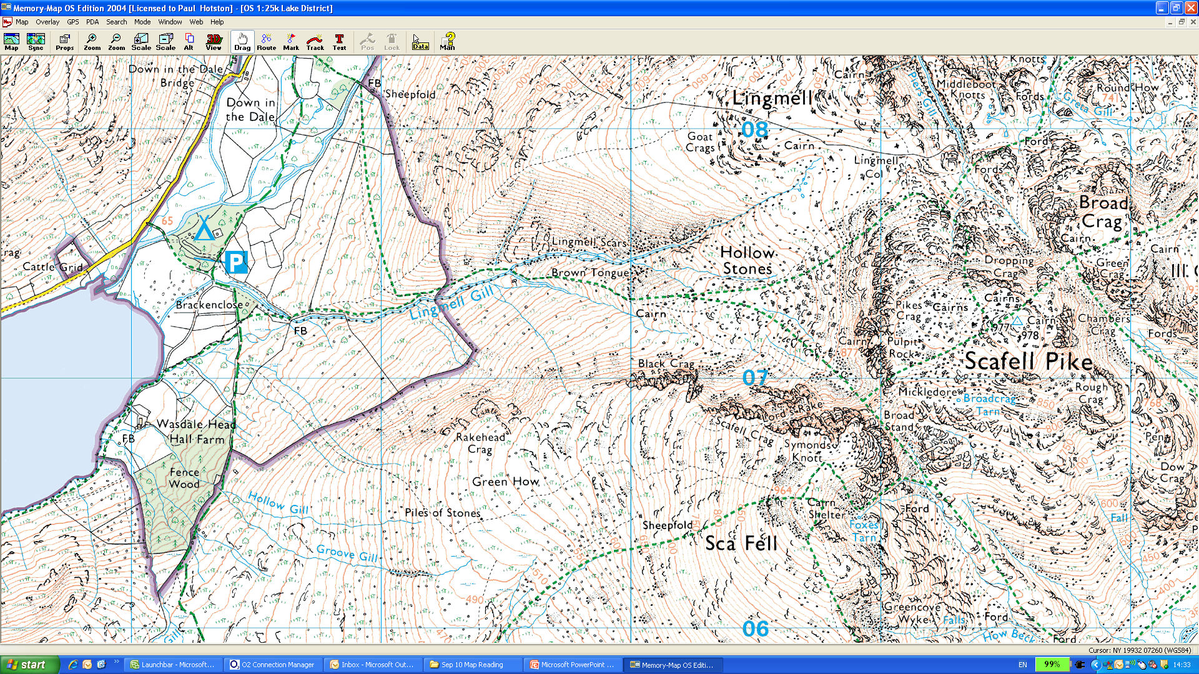
The OS map looks like this

Slide 8
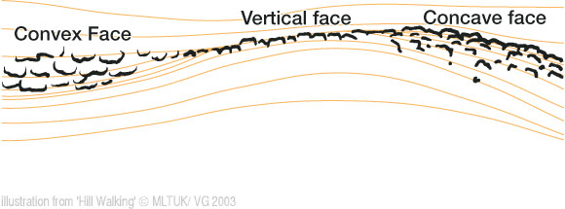
Crag Edges

Slide 9
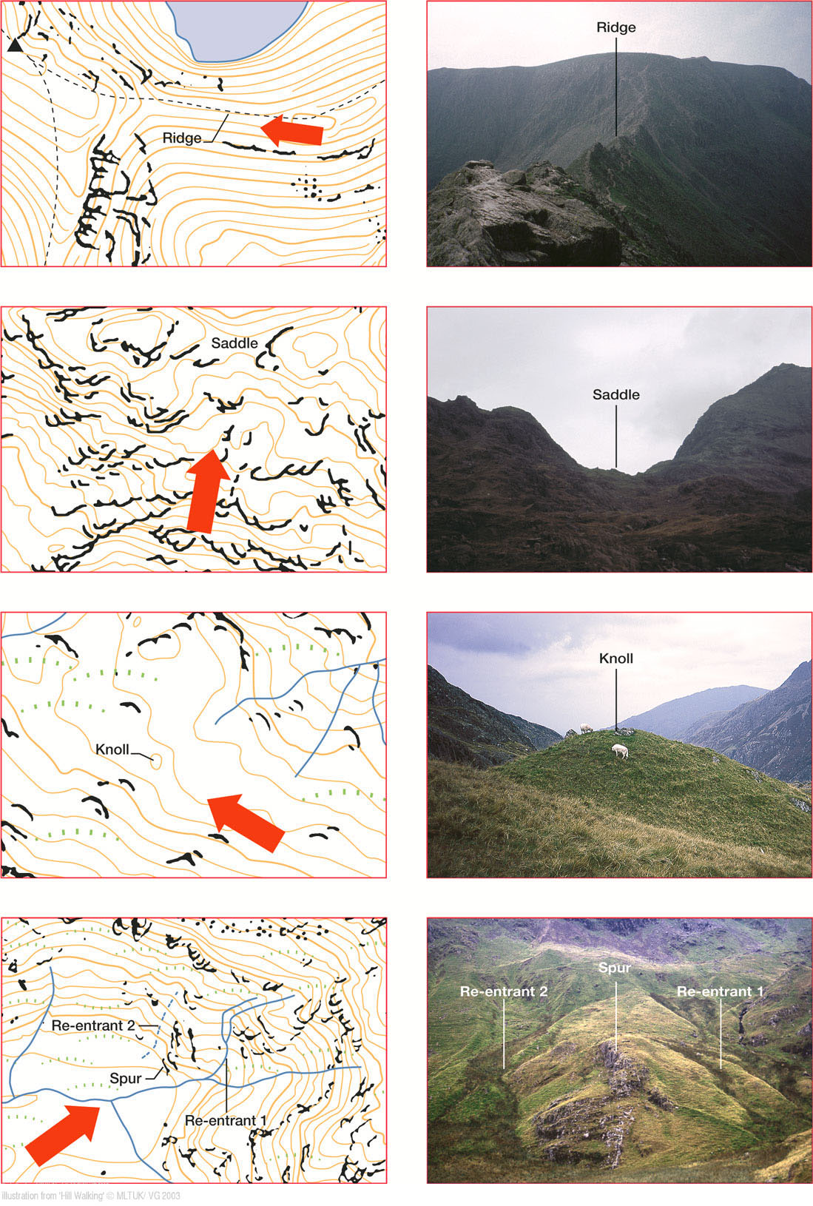
Crag Edges
Map feature
Land feature

Slide 10
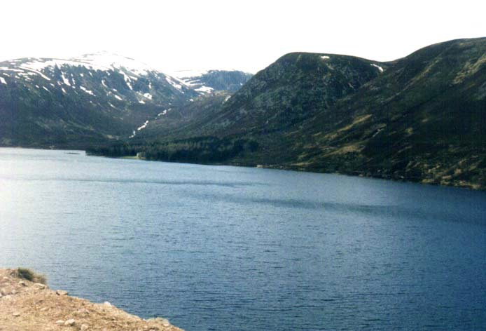
Steepness and Direction
GR 289 824 facing West

Slide 11
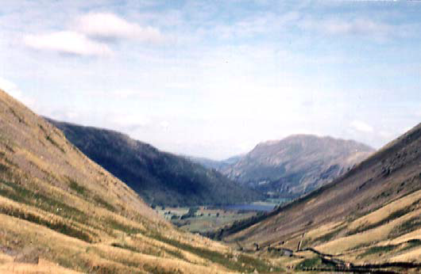
Steepness and Direction
GR 402 083 Facing North

Slide 12
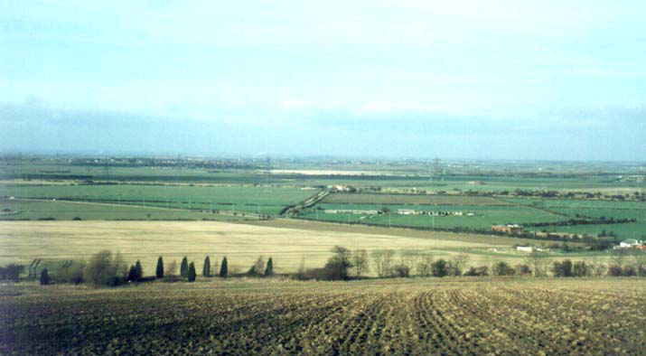
Lie of the land
GR 878 365 Facing North

Slide 13
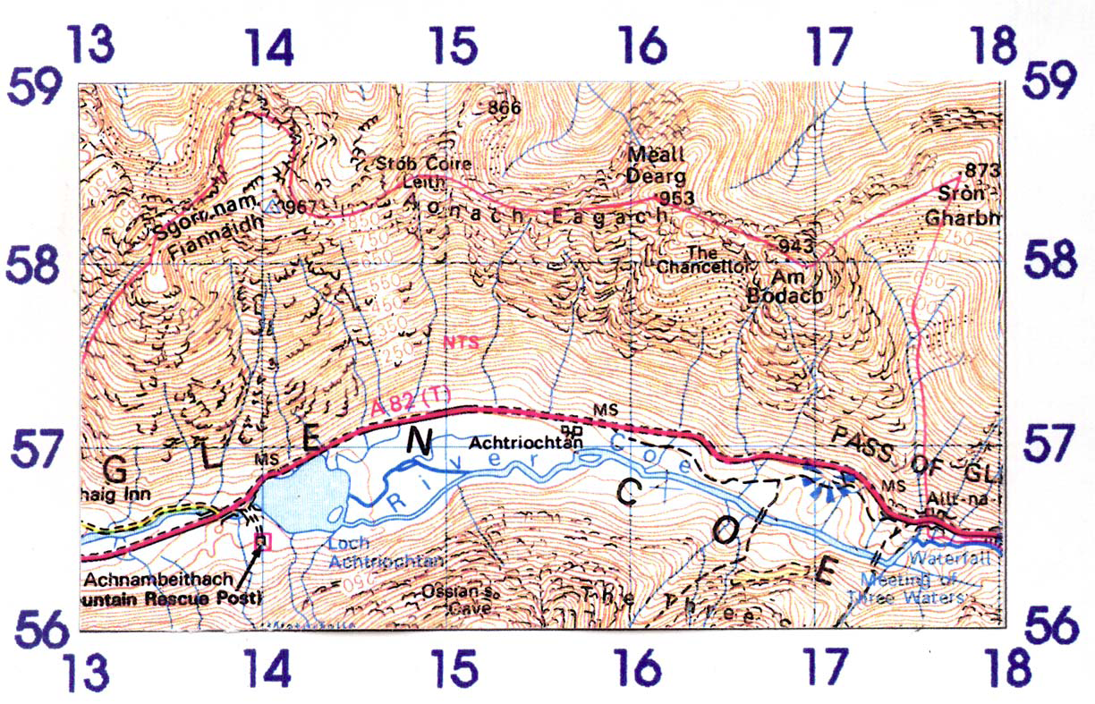
Ridges, Saddles and Cols
GR 176 567 Facing West

Slide 14
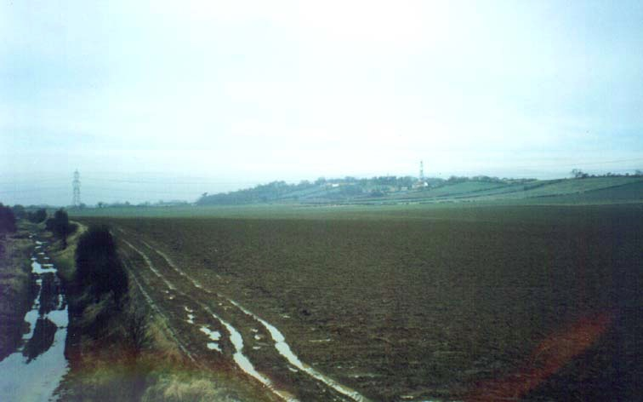
Ridges, Saddles and Cols
GR 973 589 Facing North

Slide 15
Brent Knoll and Crook Peak

Slide 16
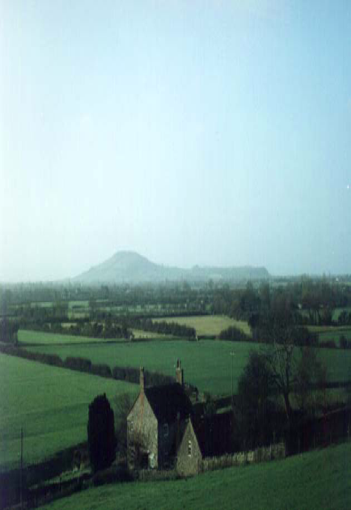
Brent Knoll
Brent Knoll from GR 389 552

Slide 17
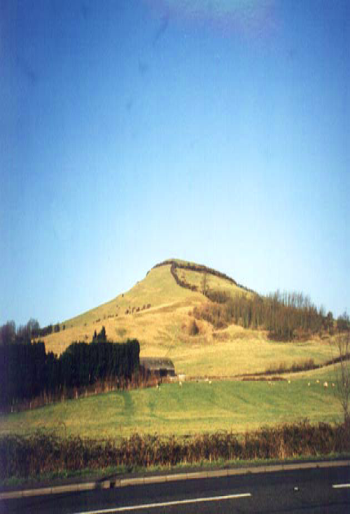
Brent Knoll
Brent Knoll from GR 349 509

Slide 18
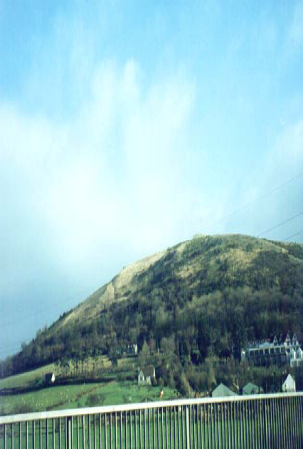
Crook Peak
Crook Peak from GR 378 555

Slide 19
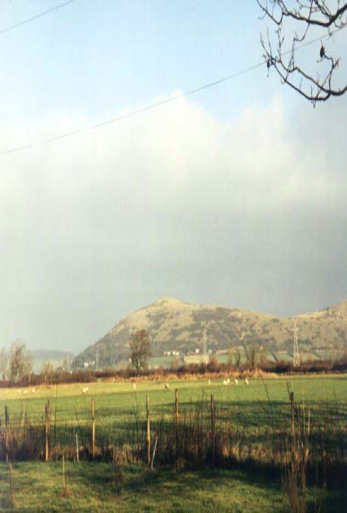
Crook Peak
Crook Peak from GR 371 525

Slide 20
Intervisibility

Slide 21
Intervisibility

Slide 22
What is Relief?
Means the rise and fall of the ground
Hills and Valleys
Maps show both the height and the shape of the land
How is this represented on a flat bit of paper though?

Slide 23
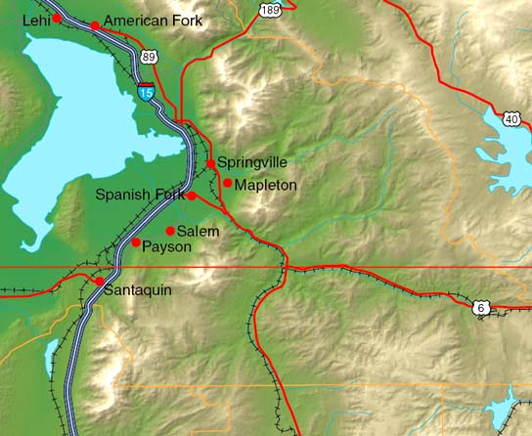
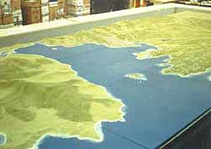
How is it shown?
Spot heights – dots on a map that show the height at that point
Layer Tinting, which represents a height band as a colour
3D maps
All have their drawbacks

Slide 24
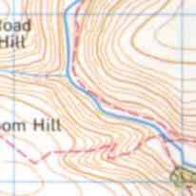
What are we going to use?
Contour lines join all points of the same height on a map
Can fairly accurately judge the shape of the land
Check the units of elevation though!

Slide 25
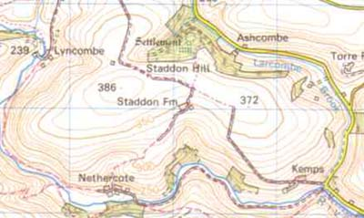
How do contour lines work?
Between any 2 lines there must be a slope up or down
Continuous except at cliffs
Shown every 10m on M726 maps, with thicker lines every 50m
Heights on lines printed so that if read right way up, you are facing uphill

Slide 26
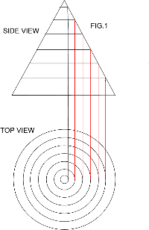
Contour plans
A map view of a hill (bottom) is like looking down on it from above
If you “project” the lines from the map, you can create a side view of the hill
You need to be able to visualise this to read contour lines properly

Slide 27
Slopes
If 2 lines are far apart, then you have to walk a long way to gain any height
This suggests a gentle slope
If 2 lines are close together, then you don’t have to walk far to gain height
This suggests a steep slope

Slide 28
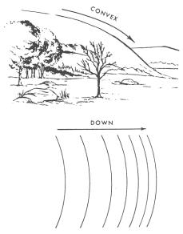
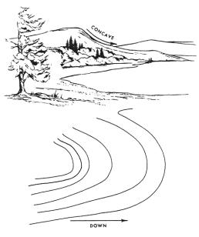
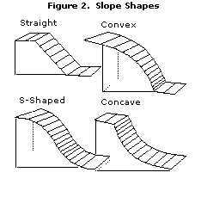
Slope shape
What is concave, what is convex?
The contour lines tell you the shape of a hill – the closer together they are, the steeper that part of the hill

Slide 29
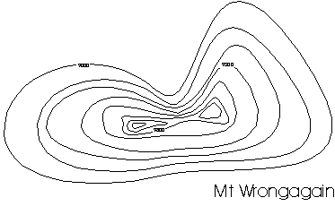
Ridges, Saddles and Cols
Long narrow stretch of elevated ground
Also known as a Saddle
Where a ridge joins 2 peaks, the bit in the middle is known as a Col

Slide 30
Ridges, Saddles and Cols
Col
Summit
Summit
Ridge
Ridge

Slide 31
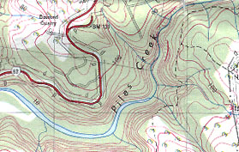
Spurs and Re-entrants
A Spur is an area of high ground which juts out into an area of low ground
A Re-entrant is a narrow valley, closed at 1 end, in between 2 spurs
Spur
Re-entrant
Spur
Re-entrant

Slide 32
Escarpments and Knolls
Escarpments are features with sides sloping away from each other – once side being very steep, and one side being shallow
The Downs are good examples of Escarpments
A knoll is a small isolated hill

Slide 33
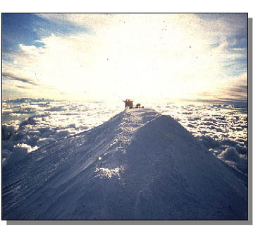
Relief
Relief refers to the way in which height is displayed on a map
This is shown by a system of lines called ‘contours’

Slide 34
If you were walking from Grizedale Youth Hostel to Brantwood House by footpaths only, what different terrain would you be walking through?
Finish
Start

Slide 35
From the car park at Brackenclose describe the two main routes to the trig point on Scafell Pike

